Slide 1
COVID-19: Investigating the Spread

Slide 2
Three Aspects of Study:
Mobility
Weather
Demographic/Socioeconomic

Slide 3
Mobility
Data Source: Google (Link)
Baseline: Median value, for the corresponding day of the week, during the 5-week period (Jan3-Feb6, 2020)
Components:
Retail and Recreation
Grocery and Pharmacy
Parks
Transit Stations
Workplaces
Residential

Slide 4
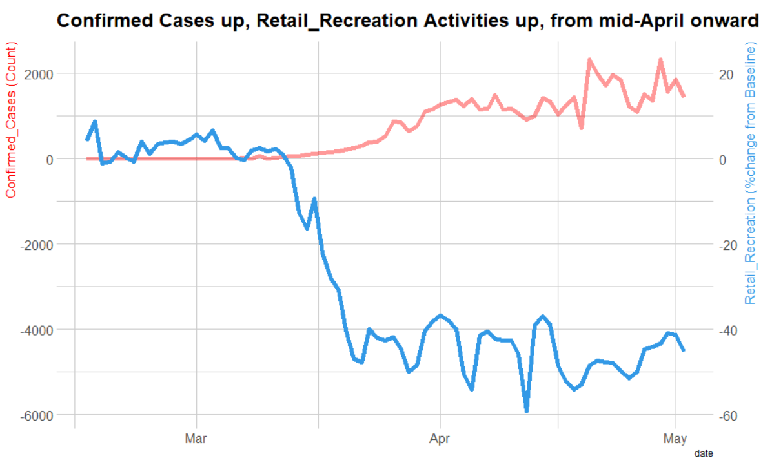

Slide 5
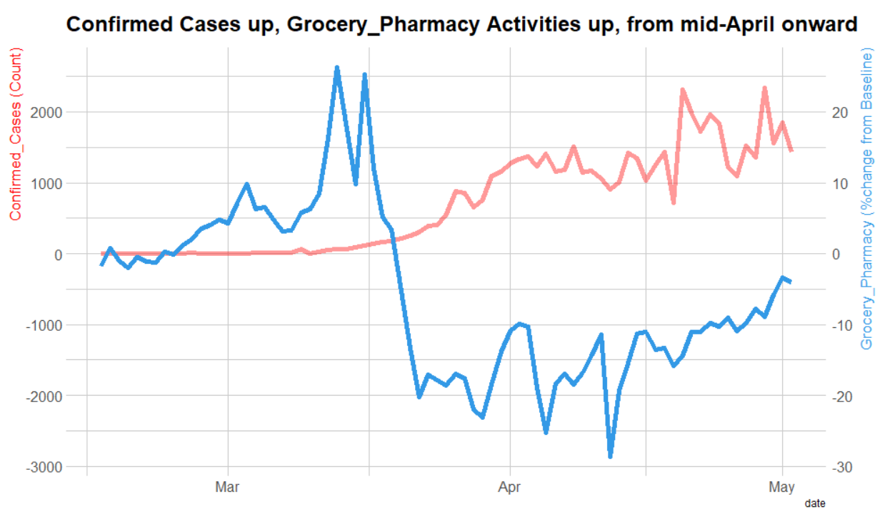

Slide 6
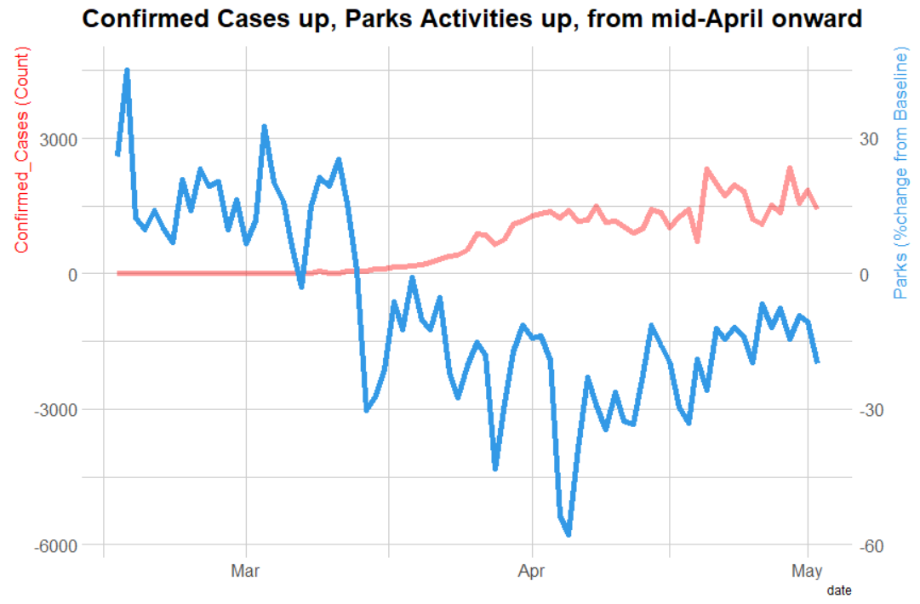

Slide 7
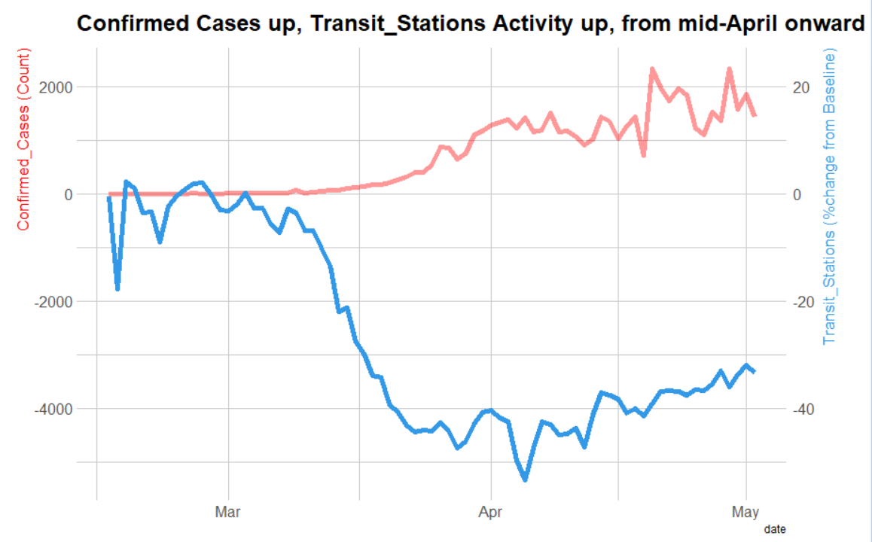

Slide 8
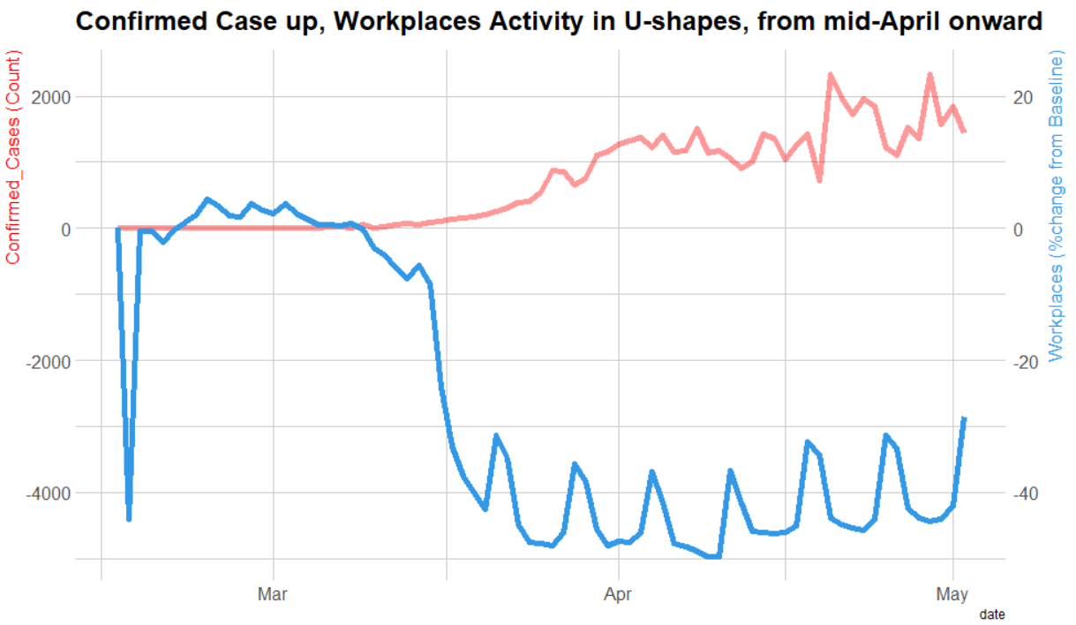

Slide 9
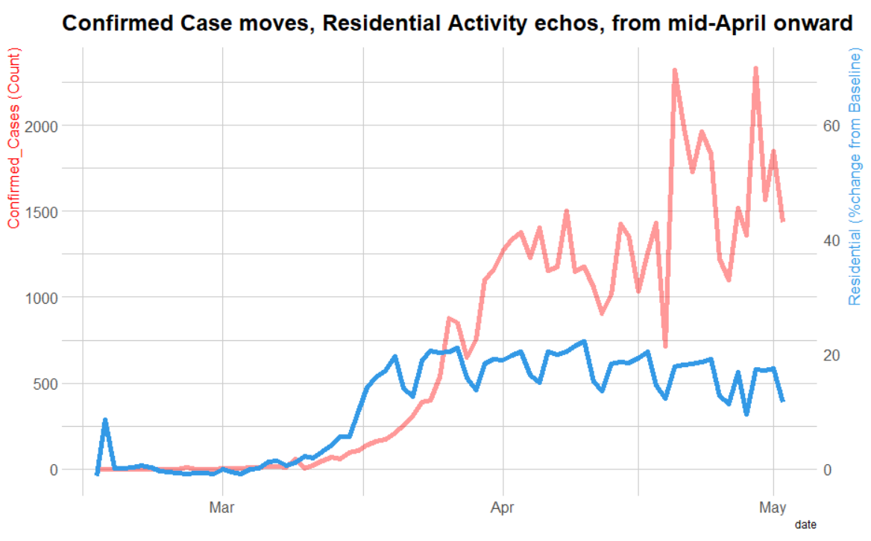

Slide 10
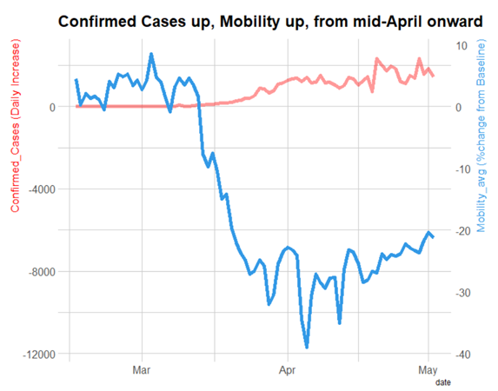

Slide 11
Mobility Average
Simple Average Aggregation
Mobility Average = (Retail_Recreation + Grocery_Pharmacy + Parks + Transit_Stations + Workplaces + Residential) / 6

Slide 12
Snapshot
Mobility correlates with virus spread well to some extent
Shutdown policy is helpful to contain virus spread
Shutdown policy works the best when people cooperate the most
Residential component is used for modeling later due to its consistency in corresponding with confirmed cases trending

Slide 13
Weather: Exploratory Data Analysis

Slide 14
Weather
Data Source: Kaggle https://www.kaggle.com/johnjdavisiv/us-counties-covid19-weather-sociohealth-data
Components:
Mean and Maximum Temperature
Dewpoint
Wind Speed
Precipitation
Conditions (rain, fog)

Slide 15
Subset and Offset
California
Incubation period is 2 weeks
Take 5 days of weather data (April 5th to April 10th) and compare it against 5 days of case data from 2 weeks after (April 20th to April 25th)

Slide 16
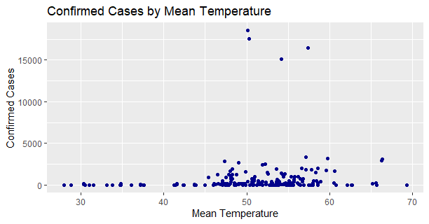

Slide 17
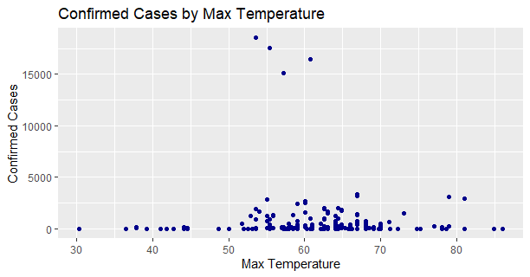

Slide 18
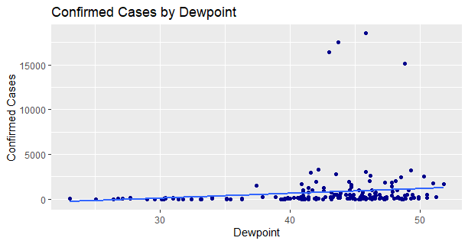

Slide 19
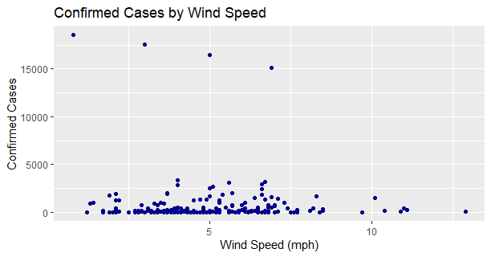

Slide 20
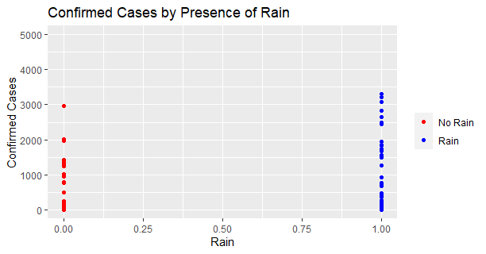

Slide 21
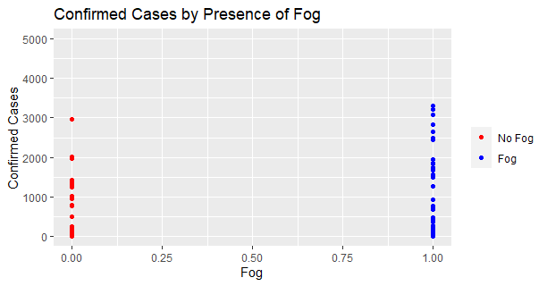

Slide 22
Variables with trends
Dewpoint
Rain
Fog

Slide 23
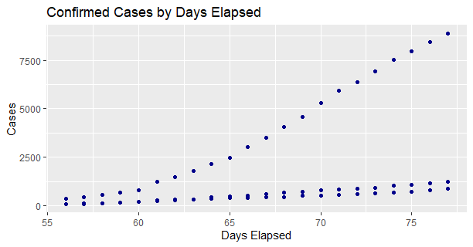
Counties: Los Angeles, Orange, San Francisco
Linear increase in cases by county
Multiply static variables by slope to make them dynamic

Slide 24
Demographic/Socioeconomic: Exploratory Data Analysis

Slide 25
Demographic/Socioeconomic EDA for California Counties
Principal Components Analysis was performed on demographic/socioeconomic data for all counties in California.
PCA determined that the highest proportion of variance could be explained by the following factors:
Population in the Labor Force per county
Number of residents 65+ per county
Total Population of a given county
Population density per square mile per county
EDA was performed for each factor against cumulative number of cases

Slide 26
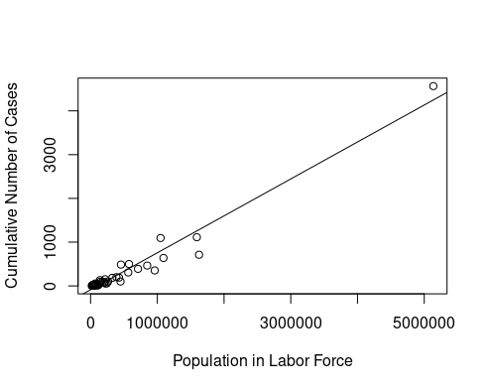
California Counties: Cumulative Number of Cases vs. Population in Labor Force

Slide 27
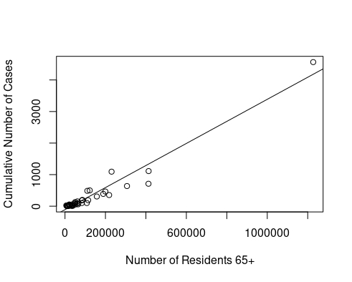
California Counties: Cumulative Number of Cases vs. Number of Residents 65+

Slide 28
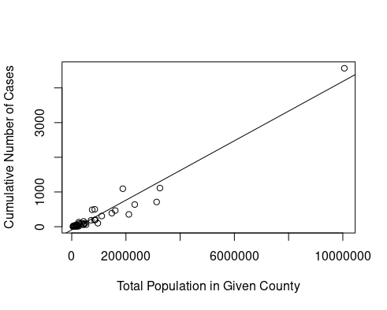
California Counties: Cumulative Number of Cases vs. Total Population

Slide 29
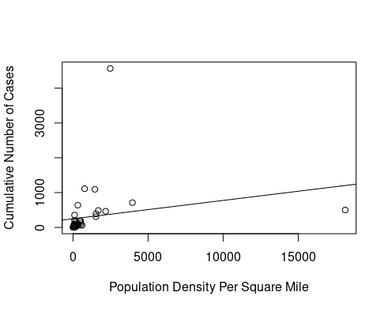
California Counties: Cumulative Number of Cases vs. Population Density

Slide 30
Coronavirus Cumulative Case Prediction in California

Slide 31
Modeling and Analysis
A multiple linear regression model was created with the following variables to predict cumulative future cases ~14 days later for a given county in California.
Factors include:
Population in labor force (Number of people in labor force for given county)
Residential Mobility (percent change on that day from baseline)
Fog (1= Fog observed in that county for that day, 0 otherwise)
Rain (1= Rain observed in that county for that day, 0 otherwise)
Dewpoint (Recorded dew point in that county during that day)

Slide 32
Modeling and Analysis
Training Data: 32 counties observations for above factors.
Test Data: 32 counties observations for above factors.

Slide 33
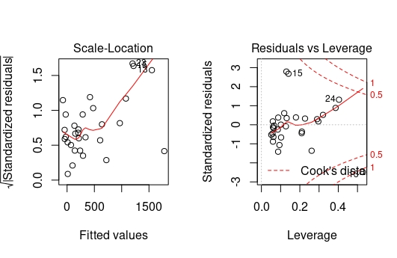
Modeling Analysis: Diagnostic Plots

Slide 34
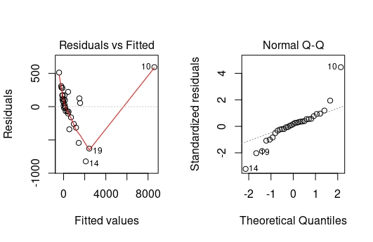
Modeling Analysis: Diagnostic Plots

Slide 35
Modeling Analysis: Future Considerations
Removal of Los Angeles County
Los Angeles county is likely “high leverage point” due to its extremely high population and corresponding number of cases.
Prediction using other models
Use of other regression models: splines, ridge regression etc.
More Weather/Mobility Data
More data post coronavirus shut down and tracking of number of cases would add fidelity to forecasting.

Slide 36
Wrap Up
California has been hit hard from cases of the SARS-COVID-2 coronavirus, but prediction can help determine its effect on the state.
Linear regression based upon socioeconomic and health factors, as well as the weather and targeted mobility data can give insight into how the coronavirus may spread.
Multiple models based upon different factors varying state to state could project the growth of the coronavirus on a national level.

